Slide 1
CORE BANKING SYSTEM
Presented by:
Group 6

Slide 2

What is expected from the system??
QCITY BANK
Customer oriented accounts.
Customer handling over his account.
Customer can avail facilities of bank.
TAKING BANKING TECHNOLOGY TO COMMON MAN

Slide 3
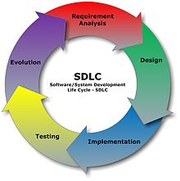
SDLC

Slide 4
USE CASES
What is an Use Case??
What is the need of Use Cases??
Who are the actors??
How can we identify them??

Slide 5
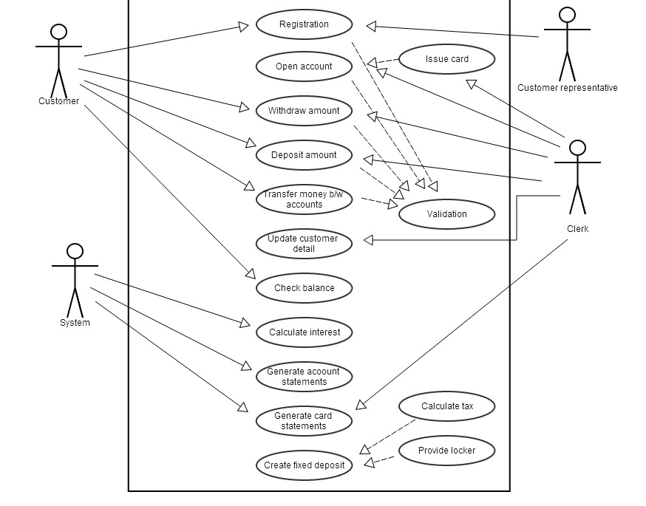
USE CASE DIAGRAM

Slide 6
USE CASE TEMPLATE
Use case Template is a way to represent use case in
proper format.
We have one template for one use case and The template
helps us in making domain and class diagrams.
Title <number> <name>
Name should be the goal as a short active verb phrase>
Level <one of: User Goal, Sub function>
Scope <what system is being considered black-box under design>
Stakeholders & their interests
Primary Actor <a role name for the primary actor, or description>
Preconditions: <what we expect is already the state of the world>
Success Guarantee:: <the state of the world upon successful completion>
Main Success Scenario
Extension (s)‏

Slide 7
REGISTER CUSTOMER
USE CASE -1 – Register Customer
LEVEL - User Goal
Primary Actor - Clerk
SCOPE - Qcity Bank
StakeHolders and Interest -Customer – Wants to Register with Qcity Bank and avail Bank
Facilities
Clerk – Records detail Provided by Customer to Register wit Bank
Qcity Bank – Wants to make Customer Registration Fast and Reliable.
Pre-Conditions - Customer Must have an account in Qcity Bank.
Customer must have some Money in his Account
Customer must know the account number of other customer.
Sucess Guarantee - Customer details given by the customer is recorded. Customer Id is generated
Main Sucess Scenario 1-Customer arrives at the bank and provides details for registration.
2 -Clerk enters the details into the system
3 -System validates the customer details.
4-System Prompts for confirmation of registration.
5-Clerk Confirms registration.
6-System generates a customer Id for the customer
7-The customer details are saved in the system
8-Clerk provides the customer Id to the customer.
Extensions - 3-Invalid Customer Details
-System displays an error message.
-System displays menu.
5-. Customer requests to stop registration.
-Clerk cancels registration process.
-System displays menu
7. System fails to save the customer details provided.
-System displays an error message.
-System displays menu.

Slide 8
DEPOSIT MONEY
USE CASE -2 :<Deposit Amount>
LEVEL : User Goal
SCOPE : Qcity Bank
PRIMARY ACTOR : Clerk
STAKEHOLDERS AND INTERESTS :
CUSTOMER : Wants to deposit money to his account
CLERK : Adds money to the account of customer in system
PRE-CONDITIONS :Customer must have a Deposit Account in Qcity bank
:customer must have an ATM card
SUCCESS GUARANTEE : Customer deposits money and his account gets creditted
MAIN SUCCESS SCENARIO :
<1> Customer Reaches to clerk for depositing money
<2> Customer fills form and give it to customer
<3> Clerk enter Details in the system
<4>Clerk matches the stored signature with the form signature
<5>Clerk verifies it
<6>Amount is added to his account
<7>Clerk gives receipt to the customer
EXTENSIONS :
4 ->Signature doesn't matches
->Clerk asks customer to refill the form
->Continue from 5

Slide 9
GET LOCKER
USE CASE- 3 :<Locker facility>
LEVEL : User Goal
SCOPE : Qcity Bank
PRIMARY ACTOR : Clerk
STAKEHOLDERS & INTEREST :
CUSTOMER : Wants to avail locker facility.
CLERK : gives a locker facility after checking the criteria for availing the facility.
PRE-CONDITIONS :Customer must have a fixed deposit account in the bank and must have amount more than one lakh.
SUCCESS GUARANTEE : locker is provided to the customer.
MAIN SUCCESS SCENARIO:
<1> customer ask clerk to provide the locker.
<2> system check for validation in providing the locker facility.
<3> all conditions verified.
<4> locker service is given to customer.
<5>.details saved and keys given to customer
EXTENSIONS :
3a->if customer do not have a valid fixed deposit account
-display error message
-display menu

Slide 10
CHECK BALANCE
USE CASE -4 :<Check balance>
LEVEL : User Goal
SCOPE : Qcity Bank
PRIMARY ACTOR : Clerk
STAKEHOLDERS & INTEREST :
Customer: Wants to check balance in his account.
Clerk : Wants the system to give details of that particular account from system.
PRE-CONDITIONS :Customer must be registered and must have at least one account in the bank.
SUCCESS GUARANTEE : balance details are displayed to user.
MAIN SUCCESS SCENARIO :
<1> Customer Reaches at bank and request to check his balance and gives his customer ID.
<2> Clerk enters the customer ID in the system .
<3> System validates user id and account number.
<4> System displays current balance.
EXTENSIONS :
3a->Invalid user ID or account and system fails to validate customer id and account number.
-system display error.
-enter again/display menu

Slide 11
DOMAIN MODEL
WHAT IS DOMAIN MODEL??
WHAT IS THE NEED OF THIS MODEL??
HOW TO IDENTIFY CLASSES??

Slide 12
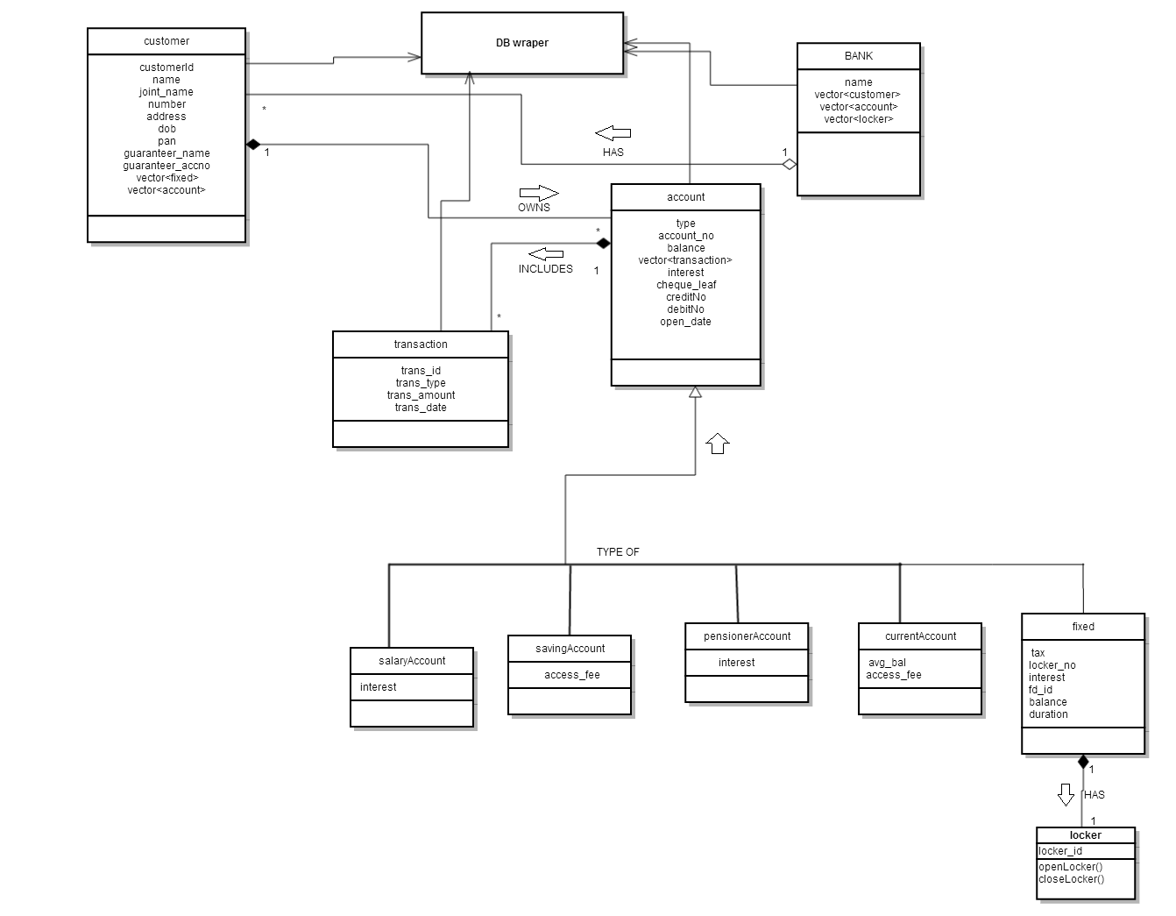
DOMAIN MODEL DIAGRAM

Slide 13
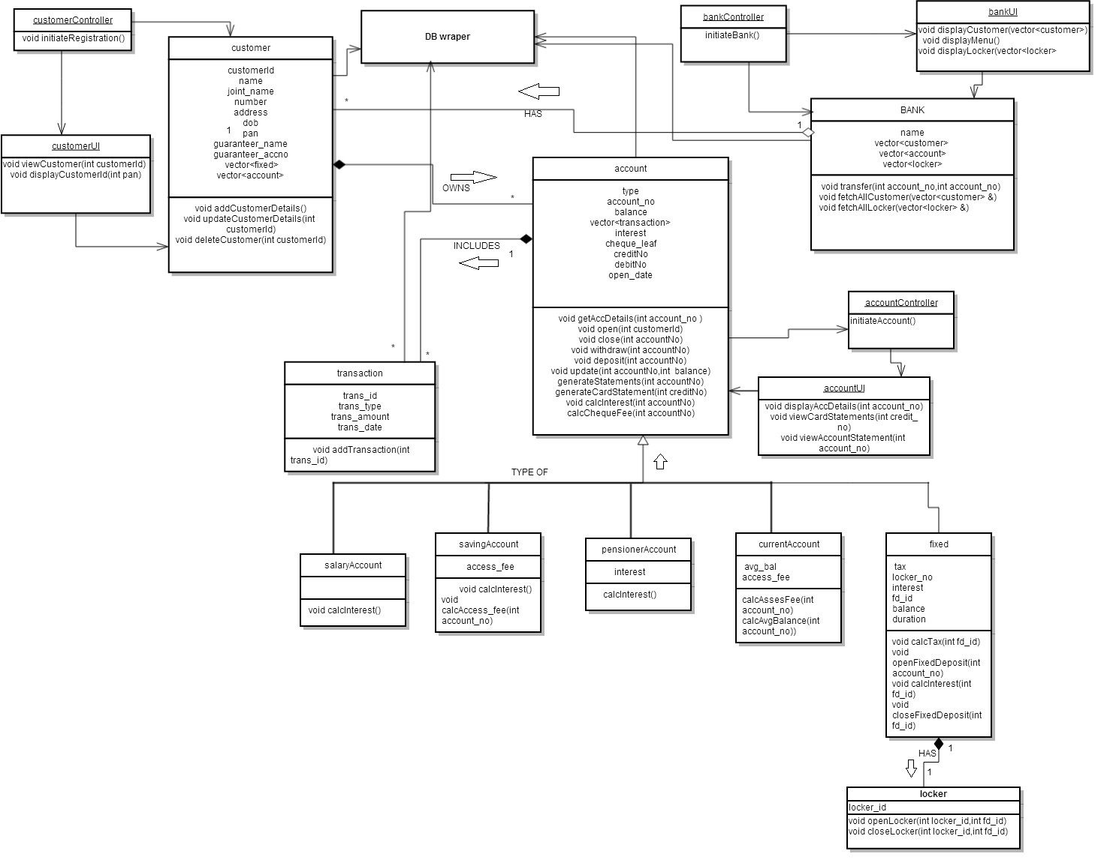
CLASS DIAGRAM

Slide 14
SEQUENCE DIAGRAM
WHAT IS THE SEQUENCE DIAGRAM??
HOW IT HELPS IN UNDERSTANDING THE FLOW ??

Slide 15
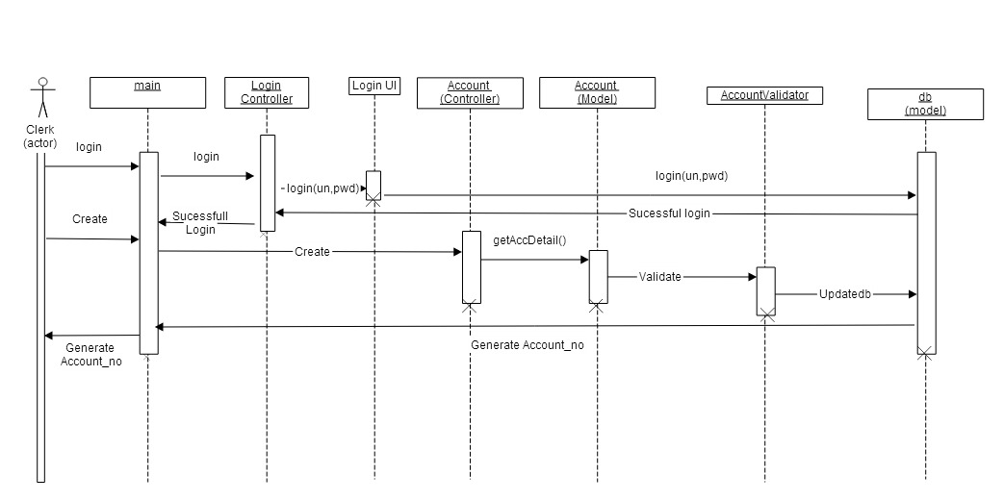
OPEN ACCOUNT

Slide 16
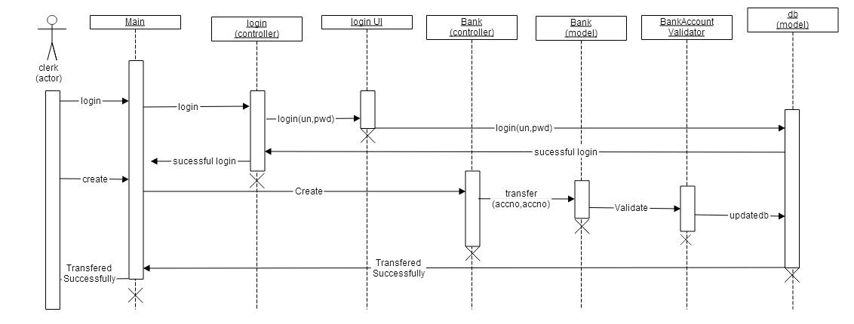
TRANSFER MONEY

Slide 17
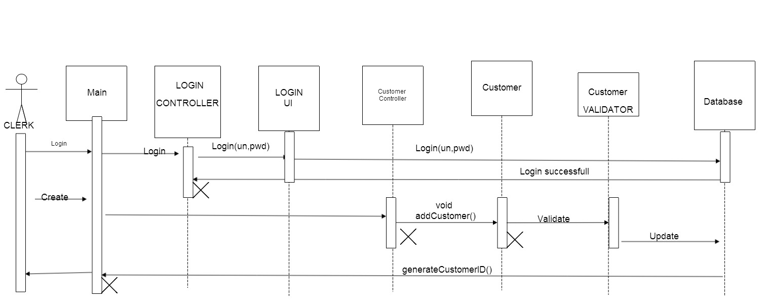
REGISTER CUSTOMER

Slide 18
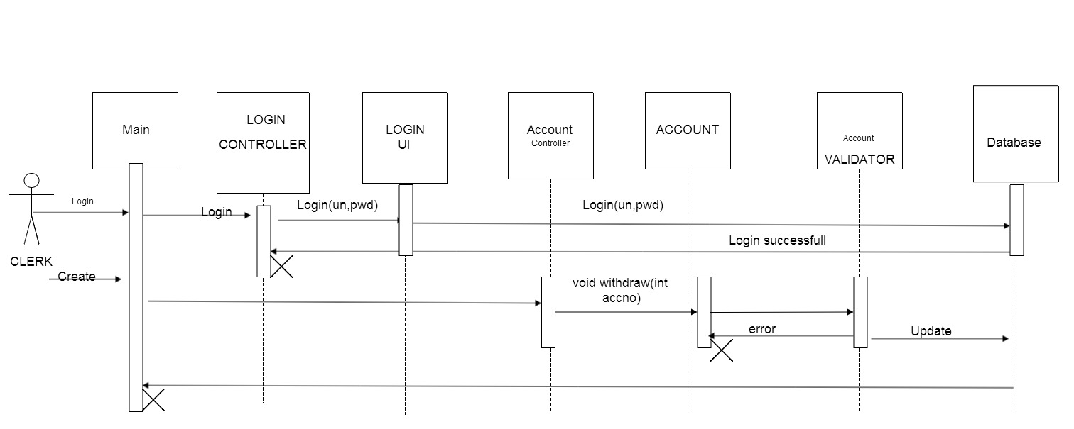
WITHDRAW MONEY

Slide 19
Thank you

